Slide 1
L5. Model Checking, Evaluating, Comparing and
Expanding models

Slide 2

Model checking is a crucial step
1. Constructing a probability model
2. Computing the posterior distribution of all estimands
3. Assessing the fit of the model to the data and to our substantive knowledge
It is impossible to include in a probability distribution all of one’s knowledge about a problem, and so it is wise to investigate what aspects of reality are not captured by the model
Reality
Model
Solution
We need to check….
prior
sampling distribution
hierarchical structure
explanatory variables…

Slide 3
Sensitivity analysis
Sensitivity analysis :
how much do posterior inferences change when other reasonable probability models are used in place of the present model?
New prior
Prior
?
Likelihood
Posterior
Information
used
Probability models
We need to examine:
How our model fail to fit reality
How sensitive the resulting posterior distributions are to arbitrary specifications

Slide 4
Sensitivity analysis
Is our model true or false?
v.s.
Do the model’s deficiencies have a noticeable effect on the substantive inferences?
Rat tumor example : Beta population distribution for tumor rates
Eight schools example : Normal distribution for the eight school effects
→ Little bit arbitrary and convenience chaise, but they have little impact on the inferences of most interests
How to judge when assumptions of convenience can be made safely is a central task of Bayesian sensitivity analysis

Slide 5
Do the inferences from the model make sense?
For reasons of convenience or objectivity,
there will be knowledge that is not included formally in either the prior or likelihood
If the additional information suggests that posterior inferences of interest are false
Potential for creating a more accurate probability model for the parameters and data collection process
External validation
Prediction about future data v.s. collected external data
Often we need to check the model before obtaining new data or waiting for the future to happen
→ Require a method of approximating external validation using the data we already have
Posterior predictive checking
Use global summaries to check the joint predictive distribution $p\left(\tilde{y}|y\right)$

Slide 6
Do the inferences from the model make sense?
Reality
Model
Inference
When inference does not capture reality,
we need more accurate probability model for the parameters and data collection process
External validation
Prediction
Measurements (external data)
Prediction about future data v.s. collected external data
When there is no external data received yet,
→ Require a method of approximating external validation using the data we already have

Slide 7
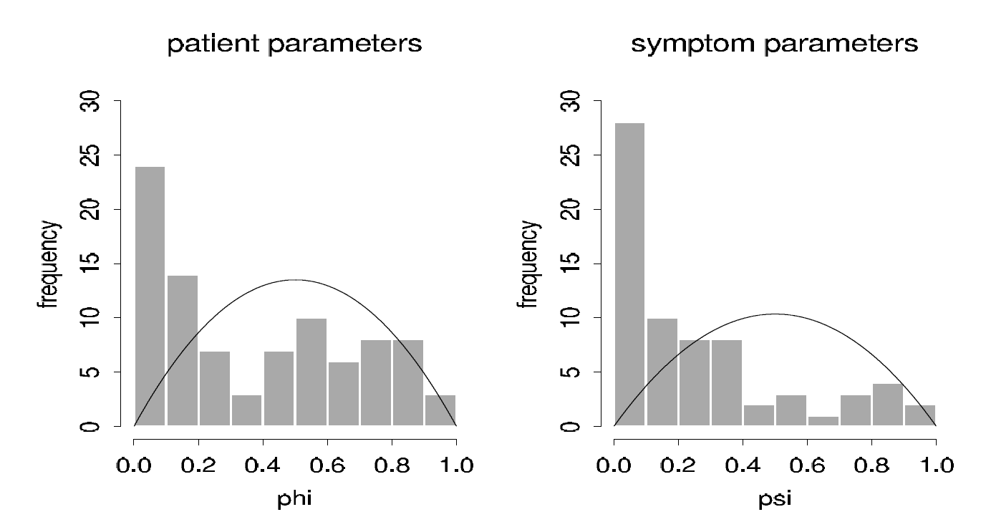
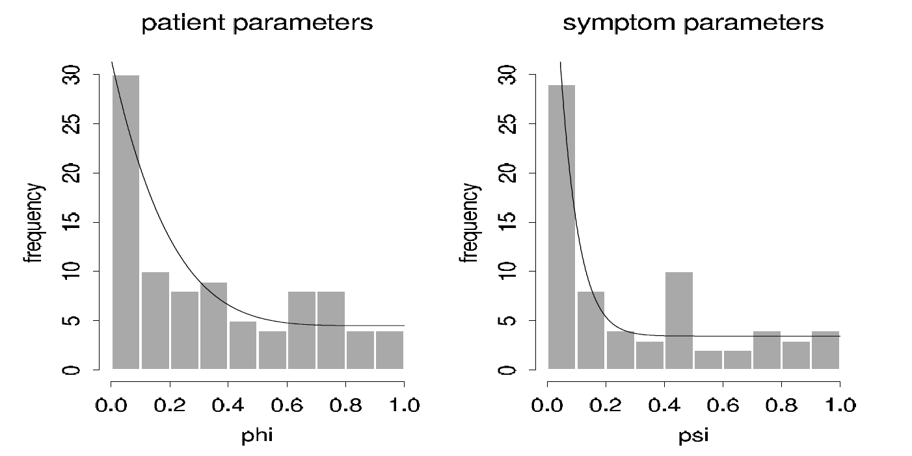


Two approaches of modal checking
Posterior predictive checking
$$p\left(\tilde{y}|y\right)$$
$\tilde{y}={\tilde{y}}_{1},…,{\tilde{y}}_{n}$ : A Joint prediction on future data
Graphical Checking

Slide 8

Posterior predictive checking
Self-consistency check:
Replicated data generated under the model should look similar to observed data. That is, the observed data should look plausible under the posterior predictive distribution
Prediction
Measurements (external data)
$$p\left(\tilde{y}|y\right)$$

Slide 9
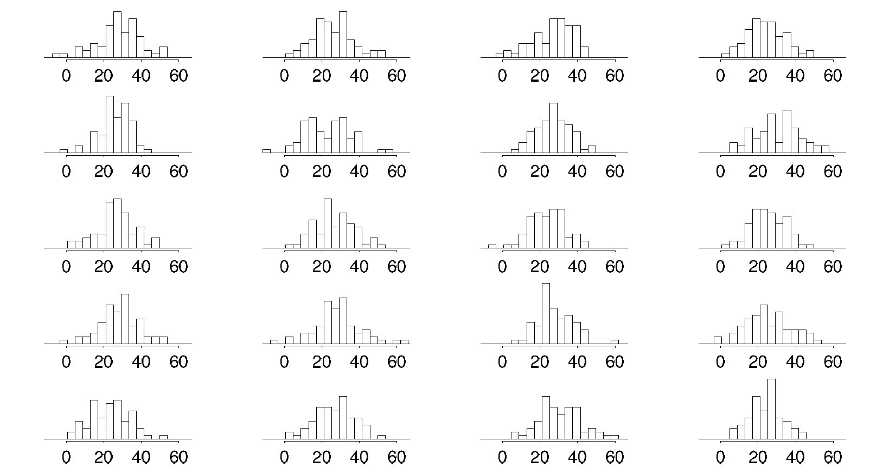
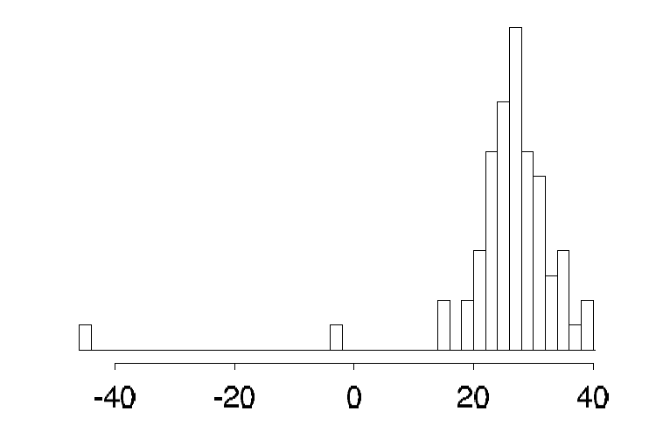


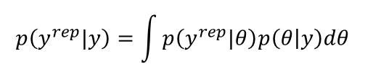









Posterior predictive checking
$y^{rep}$ is replication (simulation) of the observed data $y$ using the trained model
$$y$$
$$x$$
$$\tilde{x}$$
$$\tilde{y }$$
$$y^{rep}$$
Posterior predictive distribution on the replication is
$$p\left(y^{rep}|y\right)=\int{p\left(y^{rep}|θ\right)p\left(θ | y\right)dθ}$$
prior
$$p(μ,σ^{2})∝{\left(σ^{2}\right)}^{−1}$$
Likelihood
$$y|μ,σ^{2}\sim N(μ,σ^{2})$$
$$p\left(μ,σ^{2}|y\right)$$
Sample $\left(μ,σ^{2}\right) →$ sample 66 ${\tilde{y}}_{i}$
Too small!
Is it similar?
Actual measurement $p(y)$
Replicated $p\left(y^{rep}|y\right)$

Slide 10
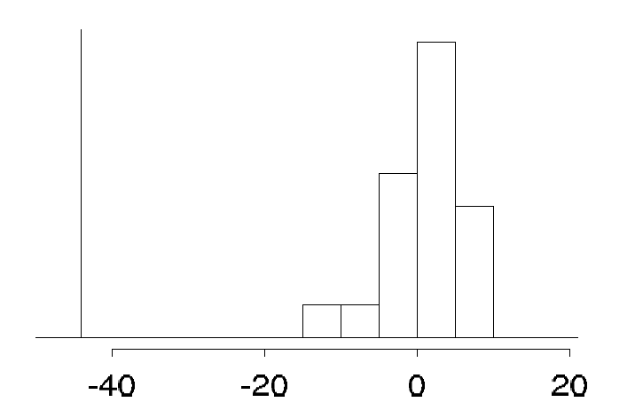



Posterior predictive checking
$y^{rep}$ is replication (simulation) of the observed data $y$ using the trained model
$$y$$
$$x$$
$$\tilde{x}$$
$$\tilde{y }$$
$$y^{rep}$$
Posterior predictive distribution on the replication is
$$p\left(y^{rep}|y\right)=\int{p\left(y^{rep}|θ\right)p\left(θ | y\right)dθ}$$
prior
$$p(μ,σ^{2})∝{\left(σ^{2}\right)}^{−1}$$
Likelihood
$$y|μ,σ^{2}\sim N(μ,σ^{2})$$
$$p\left(μ,σ^{2}|y\right)$$
Sample $\left(μ,σ^{2}\right) →$ sample 66 $y_{i}^{rep}$
Test statistics $T\left(y^{rep}\right)=\min_{i}{y_{i}^{rep}}$
$$T\left(y^{rep}\right)$$
Replicated $p\left(y^{rep}|y\right)$

Slide 11
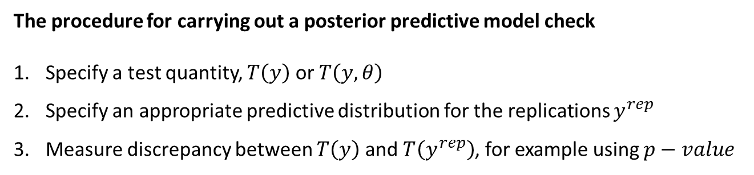

Posterior predictive checking
Test quantities
In cases with less obvious discrepancies than the outliers in the speed of light data, it is often also useful to measure the “statistical significance” of the lack of fit
Measure the discrepancy between model and data by defining test quantities
Classical setting : $T\left(y\right)$, called test statistic
Bayesian setting : $T\left(y,θ\right)$, which take into account the dependency on the model parameter $θ$
The procedure for carrying out a posterior predictive model check
Specify a test quantity, $T\left(y\right)$ or $T\left(y, θ\right)$
Specify an appropriate predictive distribution for the replications $y^{rep}$
Measure discrepancy between $T\left(y\right)$ and $T\left(y^{rep}\right)$, for example using $p−value$

Slide 12

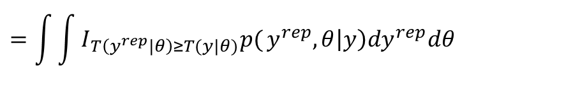


Posterior predictive checking
Tail area probability
Specifically, the p-value is defined as the probability of obtaining a result equal to or "more extreme" than what was actually observed, assuming that the model is true
Less p value→ model is not related with the data
Representative to model
P value
$$T\left(y^{rep}\right)$$
$$T(y)$$
Observed value
Classical $p−values$ : $p_{C}=Pr\left(T\left(y^{rep}\right)≥T(y)|θ\right)$
: Parameter is fixed
$θ$ is fixed and should be substituted
Bayesian $p−values$ : $p_{B}=Pr\left(T\left(y^{rep}|θ\right)≥T(y|θ)|y\right)$
: Data is fixed
$$=\int{\int{I_{T\left(y^{rep}|θ\right)≥T(y|θ)}p(}}y^{rep},θ\left|y\right)dy^{rep}dθ$$
Where the probability is taken over the posterior distribution of $θ$ and the posterior predictive distribution of $y^{rep}$, i.e., $p(θ,y^{rep}|y)$
Usually, the posterior predictive distribution can be computed using simulation :
count the number of $T\left(y^{rep_{s}},θ^{s}\right)≥T(y,θ^{s}),$ $s=1,…,S$

Slide 13
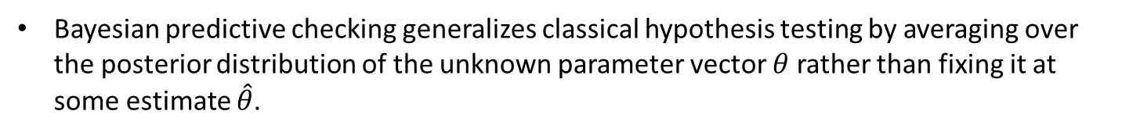
Posterior predictive p-values
An extreme p-values implies that the model cannot be expected to capture this aspect of the data.
Extreme tail-area probabilities (less than 0.01 or higher than 0.99) can be addressed by expanding the model appropriately.
Typically, we evaluate a model with respect to several test quantities
Not : Do the data come from the assumed model?
Yes : Quantify the discrepancies between data and model, and assess whether they could have arisen by chance, under the model’s own assumptions.
Bayesian predictive checking generalizes classical hypothesis testing by averaging over the posterior distribution of the unknown parameter vector $θ$ rather than fixing it at some estimate $\hat{θ}$.

Slide 14
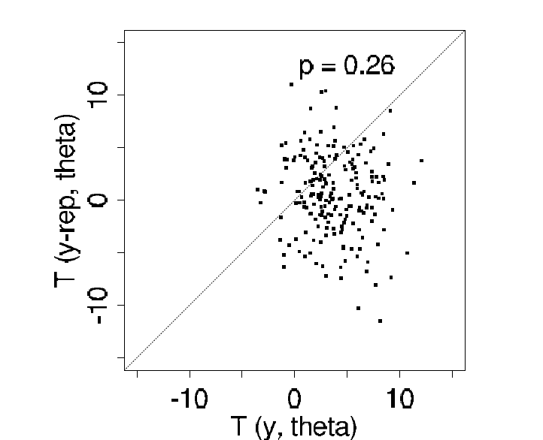
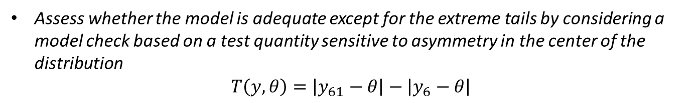


Speed of light example with test quantity
Use other test quantities to illustrate how the fit of a model depends on the aspects of the data and parameters being monitored.
Assess whether the model is adequate except for the extreme tails by considering a model check based on a test quantity sensitive to asymmetry in the center of the distribution
$$T\left(y, θ\right)=\left|y_{61}−θ\right|−\left|y_{6}−θ\right|$$
The 61st and 6th order statistics are chosen to represent approximately the 90% and 10% points of the distribution.
The test quantity should be scattered about zero for a symmetric distribution.
$$T\left(y^{rep}, θ\right)$$
$$T\left(y, θ\right)$$

Slide 15
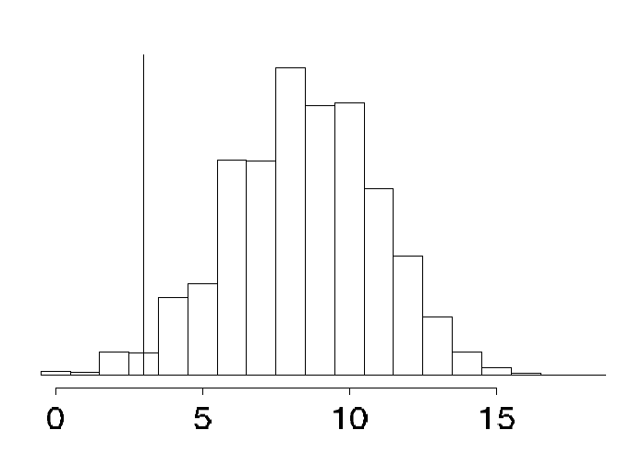

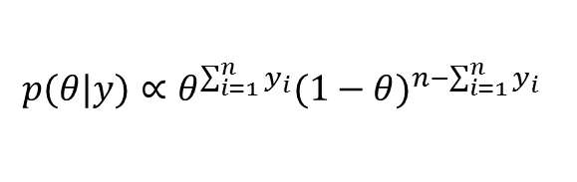
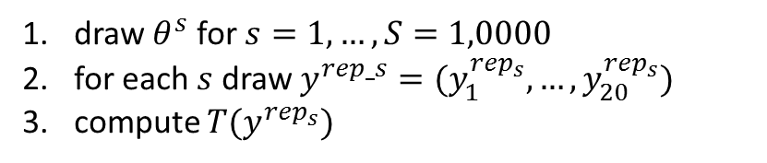
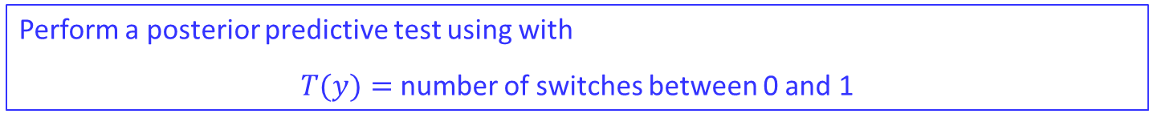

Choosing test quantities
Example: Check the independence assumption
A sequence of binary outcomes, $y_{1},…,y_{n},$ modeled as specified number of independent trial with a common probability of success, $θ$, that is given a uniform prior distribution.
$$p(θ|y)∝θ^{\sum_{i=1}^{n}{y_{i}}}{(1−θ)}^{n−\sum_{i=1}^{n}{y_{i}}}$$
The posterior distribution is
Perform a posterior predictive test using with
$T(y)=$ number of switches between 0 and 1
Observed data: $y=\left(y_{1},…,y_{n}\right)=\left(1,1,0,0,0,0,0,1,1,1,1,1,0,0,0,0,0,0,0,0\right)→T\left(y\right)=3$
draw $θ^{s}$ for $s=1,…,S=1,0000$
for each $s$ draw $y^{rep_s}=(y_{1}^{rep_{s}},…,y_{20}^{rep_{s}})$
compute ${T(y}_{ }^{rep_{s}})$
$$T\left(y\right)=3$$
$p−value$ = 0.9838:
The discrepancy cannot be explained by chance, but is likely to be explained by modeling failure

Slide 16
Choosing test quantities
Posterior predictive checking is a useful direct way of assessing the fit of the model to these various aspects of the data.
Ideally, the test quantities T will be chosen to reflect aspects of the model that are relevant to the scientific purposes to which the inference will be applied.
Test quantities are commonly chosen to measure a feature of the data not directly addressed by the probability model; for example, ranking and correlation

Slide 17
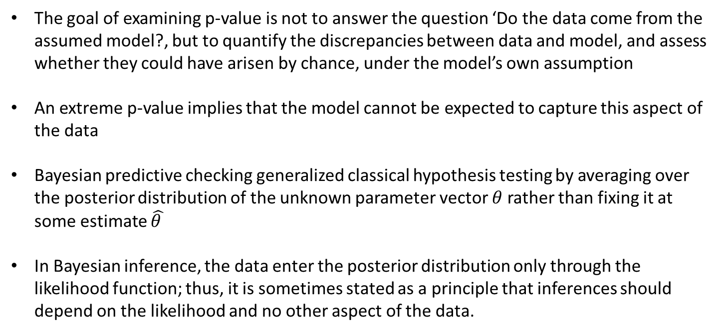
Interpreting posterior (Bayesian) p-values
The goal of examining p-value is not to answer the question ‘Do the data come from the assumed model?, but to quantify the discrepancies between data and model, and assess whether they could have arisen by chance, under the model’s own assumption
An extreme p-value implies that the model cannot be expected to capture this aspect of the data
Bayesian predictive checking generalized classical hypothesis testing by averaging over the posterior distribution of the unknown parameter vector $θ$ rather than fixing it at some estimate $\hat{θ }$
In Bayesian inference, the data enter the posterior distribution only through the likelihood function; thus, it is sometimes stated as a principle that inferences should depend on the likelihood and no other aspect of the data.

Slide 18

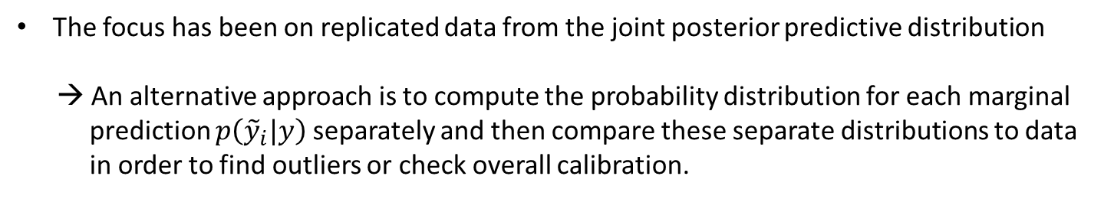


Marginal predictive checks
The focus has been on replicated data from the joint posterior predictive distribution
→ An alternative approach is to compute the probability distribution for each marginal
prediction $p\left({\tilde{y}}_{i}|y\right)$ separately and then compare these separate distributions to data
in order to find outliers or check overall calibration.
$$p_{i}=Pr\left(T\left(y_{i}^{rep}\right)≤T(y_{i})|y\right)$$
If $y_{i}$ is scalar,
$$p_{i}=Pr\left(y_{i}^{rep}≤y_{i}|y\right)$$
A related approach is to replace predictive distributions with cross-validation predictive distributions, for each data point comparing to the inference given all the other data.
$$p_{i}=Pr\left(y_{i}^{rep}≤y_{i}|y_{−i}\right)$$

Slide 19
Graphical posterior predictive checks
Graphical model checking is to display the data alongside simulated data from the fitted model, and to look for systematic discrepancies between real and simulated data from the fitted model, and look for systematic discrepancies between real and simulated data.
Direct display of all the data
Display of data summaries or parameter inferences
Graphs of residuals or other measures of discrepancy between model and data

Slide 20
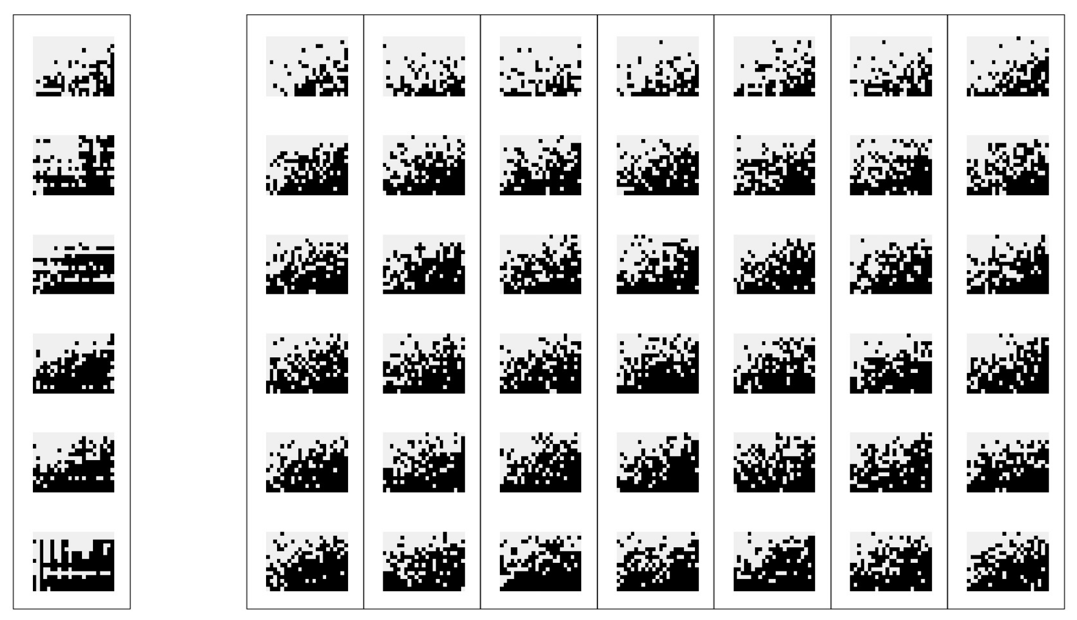


Direct display of all the data
Experiment in Psychology
15 yes/no responses
simulation 1
simulation 7
Person 1
23 situation
Person 2
Person 3
Person 4
Person 5
Person 6
Model
misfit
Persons are ordered with their response rate
$$T(y)$$
$$T(y^{rep})$$
Graphical representations with special ordering itself is a test statistics

Slide 21



Displaying summary statistics or inferences
Inference from a hierarchical model from psychology (Model specification is now shown here)
Two vector of parameters:
Patient parameters: $φ_{1},…,φ_{90}$
Psychological symptom parameters: $ψ_{1},…,ψ_{69}$
$$p\left(φ_{i}\right)\sim Beta\left(φ_{i} | 2,2\right)$$
$$p\left(φ_{i}\right)=0.5Beta\left(φ_{i} | 1,6\right)+0.5Beta(φ_{i}|1,1)$$
$$p\left(ψ_{i}\right)\sim Beta\left(φ_{i} | 2,2\right)$$
$$p\left(ψ_{i}\right)=0.5Beta\left(φ_{i} | 1,16\right)+0.5Beta(φ_{i}|1,1)$$
data drawn from
the posterior dist.
Prior distribution can be viewed as a posterior predictive check in which a new set of patients and symptom parameters.

Slide 22
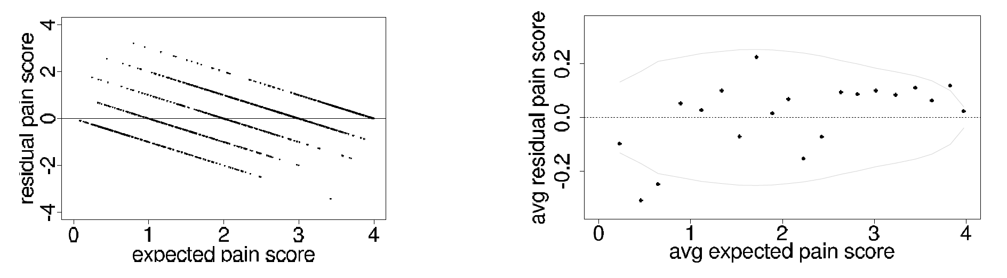

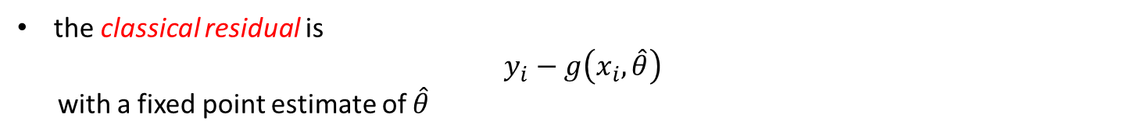

Residual plots and binned residual plots
Linear or nonlinear regression model
$$g\left(x,θ\right)=E(y|x, θ)$$
Given unknown parameter $θ$ and the predictors $x_{i}$ for a data point$y_{i}$, the realized residual is
$y_{i}−g\left(x_{i},θ\right)$
the classical residual is
$y_{i}−g\left(x_{i},\hat{θ}\right)$
with a fixed point estimate of $\hat{θ}$
The binned residual plot

Slide 23
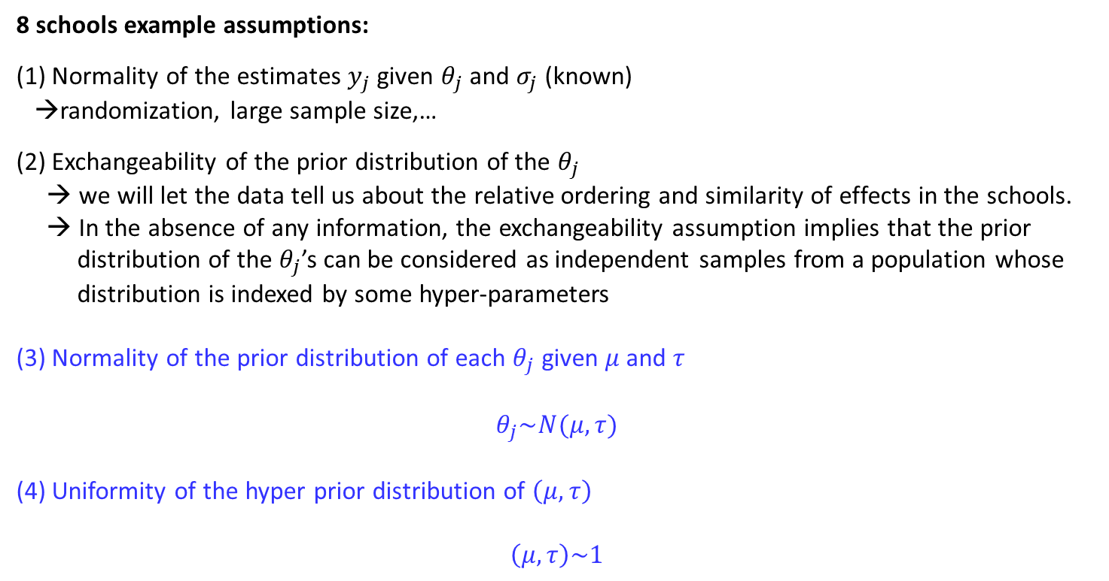
Graphical model checking for the 8 schools example
8 schools example assumptions:
(1) Normality of the estimates $y_{j}$ given $θ_{j}$ and $σ_{j}$ (known)
→randomization, large sample size,…
(2) Exchangeability of the prior distribution of the $θ_{j}$
→ we will let the data tell us about the relative ordering and similarity of effects in the schools.
→ In the absence of any information, the exchangeability assumption implies that the prior
distribution of the $θ_{j}$’s can be considered as independent samples from a population whose
distribution is indexed by some hyper-parameters
(3) Normality of the prior distribution of each $θ_{j}$ given $μ$ and $τ$
$$θ_{j}\sim N(μ,τ)$$
(4) Uniformity of the hyper prior distribution of $\left(μ,τ\right)$
$$\left(μ,τ\right)\sim 1$$
(3) And (4) are hard to justify (before seeing data)
Mathematical tractability is one reason for the choice of models, but if the family of probability models is inappropriate, Bayesian answers can be misleading

Slide 24
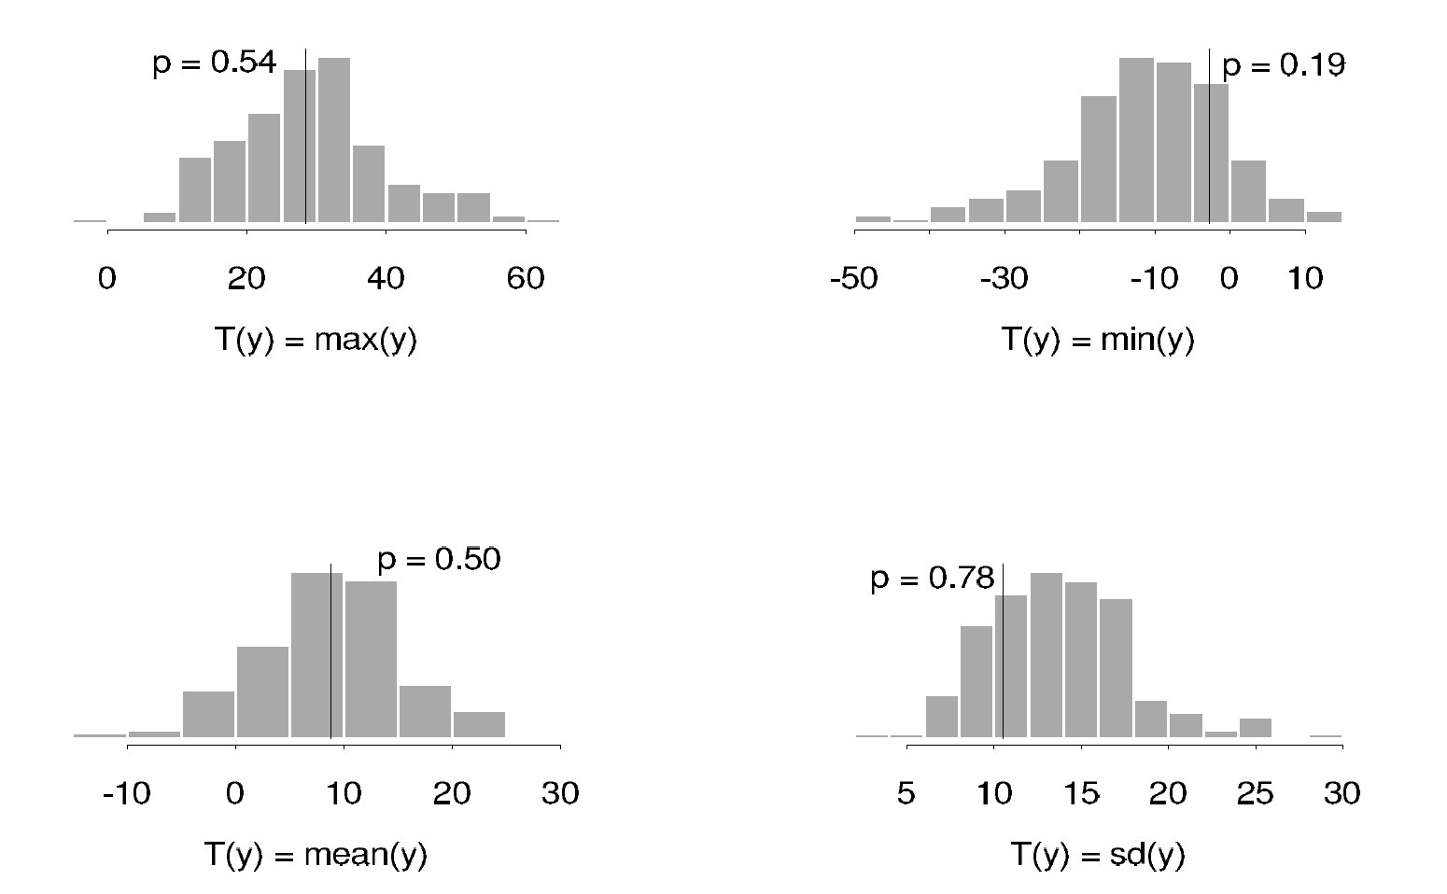
Posterior predictive checking
School Coaching Example: Suppose we perform 200 posterior predictive simulations of the coaching experiments
Posterior predictive distribution
The summaries suggest that the model generates predicted results similar to the observed data in the study: that is, the actual observations are typical of the predicted observations generated by the model
Other reasonable models might provide just as good a fit but lead to different conclusions. Sensitivity analysis can then be used to assess the effect of alternative analyses on the posterior inferences.

